Slide 1

Islamic University of Technology
Course no: Phy 4143
Course Title: Physics II
Course Teacher : Dr Md. Sahab Uddin
Professor

Slide 2
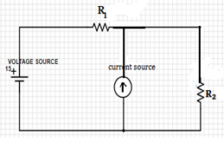
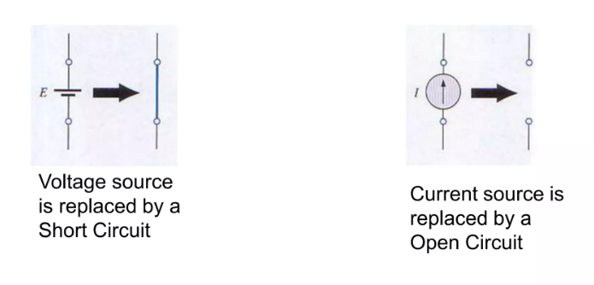
Superposition theorem
Statement: According to this theorem, if there are number of voltage and current sources acting simultaneously in a network then each source can be treated as if it acts independently of the others. Hence we can calculate effect of one source at a time then superimpose i.e. algebraically add the effects of all the sources.
Step 1: First all the sources except one under consideration are removed. While removing these voltage sources their internal resistance are left behind, while removing the current sources, as their internal resistance is infinite they are replaced by an open circuit.
Step 2: Next current in the various branches and voltage across various branches due to single source is calculated.
Step 3: The process is repeated for other sources taken one at a time.
Step 4: Finally algebraic sum of currents and voltage drop across the resistors due to different sources is calculated.

Slide 3
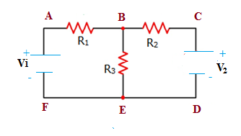
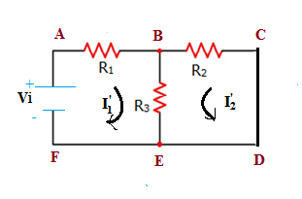
Explanation
Step 1 : When V₁ is operated and V₂ is short circuited
Let I₁ is the total current through the network when V₁ is operated alone.
I₁’ and I₂’ are the loop currents in the loops 1 and 2 respectively as shown in the figure.
Then I₁= I₁’ + I₂’
Apply KVL for loop 1: I₁’ R₁+ (I₁’ + I₂’ )R₃ = V₁
Or I₁’ (R₁+ R₃) + I₂’ R₃ = V₁ ..(1)
Apply KVL for loop 2: I₂’ R₂+ (I₁’ + I₂’ )R₃ = 0
Or I₁’ R₃ + I₂’(R₂ +R₃) = 0 ..(2)
Solving simultaneous equations 1 & 2, I₁’ and I₂’ can be calculated and hence I₁ = I₁’ + I₂’ can be calculated.

Slide 4
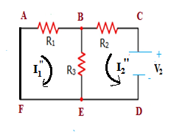
Step 2: When V₂ is operated and V₁ is short circuited
Let I₂ is the total current through the network when V₂ is operated alone.
I₁” and I₂” are the loop currents in the loops 1 and 2 respectively as shown in the figure.
Then I₂= I₁” + I₂”
Apply KVL for loop 1: I₁” R₁+ (I₁” + I₂” )R₃ = 0
Or I₁” (R₁+ R₃) + I₂” R₃ = 0 ..(3)
Apply KVL for loop 2: I₂” R₂+ (I₁” + I₂” )R₃ = V₂
Or I₁” R₃ + I₂” (R₂ +R₃) = V₂ ..(4)
Solving simultaneous equations 3 & 4 I₁” and I₂” can be calculated and hence I₂ = I₁” + I₂” can be calculated
Finally algebraic sum of currents I₁ and I₂ due to sources V₁ and V₂ is calculated

Slide 5
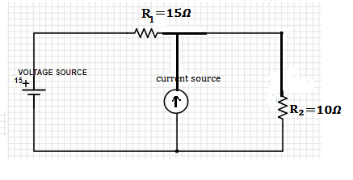
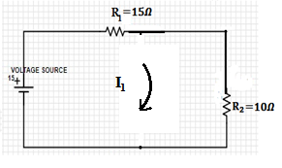


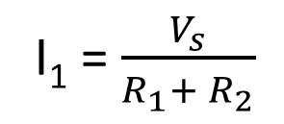
Problem-1
Using superposition theorem find the voltage across 10𝛺 resistor
Step 1 :, we keep only voltage source active
and the current source is removed and replaced by open branch.
So the circuit will become as shown in the figure.
I₁ = $\frac{V_{s}}{R_{1}+ R_{2}}$
= $\frac{15}{15+10}$
$=\frac{15}{25}$ A
current through R₂ is

Slide 6
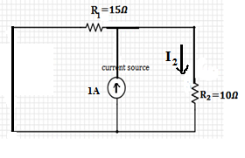
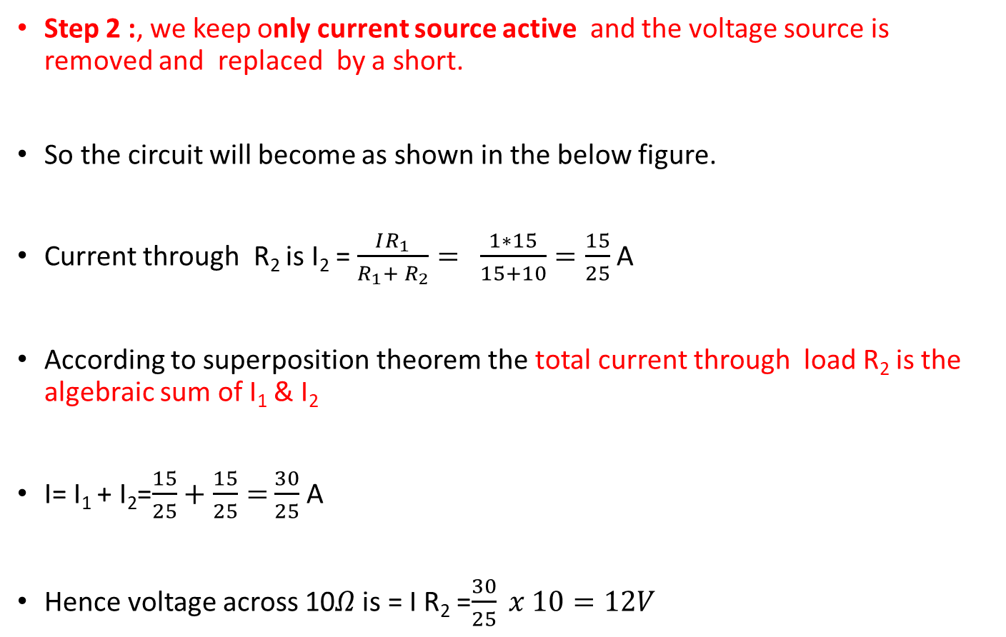
Step 2 :, we keep only current source active and the voltage source is removed and replaced by a short.
So the circuit will become as shown in the below figure.
Current through R₂ is I₂ = $\frac{IR_{1}}{R_{1}+ R_{2}}=$ $\frac{1∗15}{15+10}=\frac{15}{25}$A
According to superposition theorem the total current through load R₂ is the algebraic sum of I₁ & I₂
I= I₁ + I₂=$\frac{15}{25}+\frac{15}{25}=$ $\frac{30}{25}$ A
Hence voltage across 10𝛺 is = I R₂ =$\frac{30}{25} x 10=12V$

Slide 7
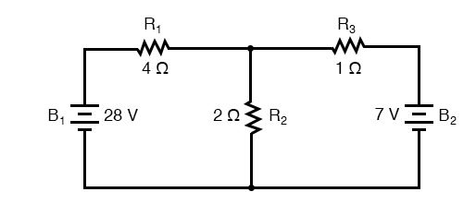
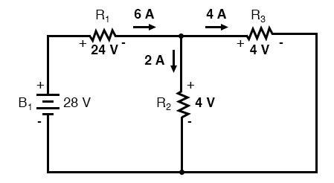

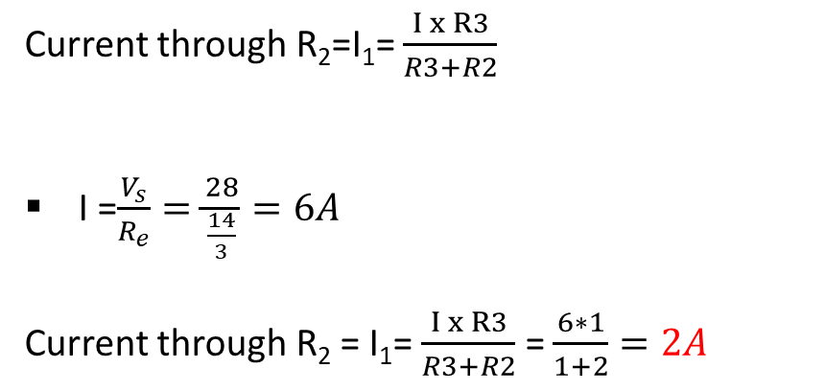
Problem-2
Using superposition theorem find the voltage across 2𝛺 resistor
Step 1: only the 28-volt battery is active and 7 volt battery is replaced by a short
Current through R₂=I₁= $\frac{I x R3}{R3+R2}$
I =$\frac{V_{s}}{R_{e}}=\frac{28}{\frac{14}{3}}=6A$
Current through R₂ = I₁= $\frac{I x R3}{R3+R2}$ = $\frac{6∗1}{1+2}=2A$
$R_{e}=4+2 ⃦1=4+\frac{2∗1}{2+1}= 4+\frac{2}{3}=\frac{14}{3}Ω$

Slide 8
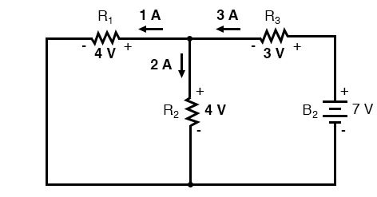

Step 2: only the7-volt battery is active and 28 volt battery is replaced by a short
Current through R₂ = I₂= $\frac{I x R1}{R1+R2}$
$$R_{e}=1+4 ⃦2=1+\frac{4∗2}{4+2}= 1+\frac{8}{6}= \frac{7}{3}Ω$$
I=$\frac{V_{s}}{R_{e}}=\frac{7}{\frac{7}{3}}=3A$
Current through R₂= $\frac{I x R1}{R1+R2}$ = $\frac{3∗4}{4+2}=2A$
Hence the total current through R₂ is 2+2=4A and
Voltage drop across R₂ = current through R₂ $∗$ R₂ = 4$∗2=$ 8V

Slide 9
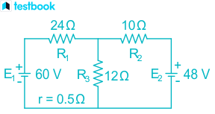
Example1: Determine the current in each branch of the network using superposition theorem

Slide 10
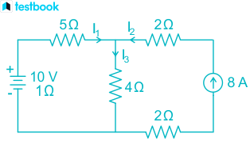
Example 2: Determine the current in each branch of the network using superposition theorem

